Slide 1
Attrition Calculator for Managers Capstone Project by Mei Yee

Slide 2
Attrition Costs Money
Hiring efforts
Brain drain
Resource reallocation
Disruption in success
Loss in staff morale
Notes:
We all know that attrition (people resigning) costs the company money, but in what way?
Effort to replace staff (job postings, hiring processes, paperwork and new hire training)
Brain drain (loss of skilled and experienced staff)
Need to reallocate and train existing staff before new hire arrives
Disruption in succession planning (for management level staff)
Loss in staff morale (more staff leaving)

Slide 3
16.1% ( 237 out of 1470 staff )
Attrition is high!
Notes:
There is a problem with attrition in this company.

Slide 4
Attrition Calculator
App to help companies reduce attrition costs by predicting chance of staff leaving for early intervention
Notes:
To help improve attrition, I would like to propose implementing the attrition calculator, which aims to help the company reduce attrition costs by predicting chance of staff leaving for early intervention.

Slide 5
Objectives
Exploring Attrition Trends
Model Building
Calculator Demo
Notes:
Let’s go through how the model is built with our company’s staff data.
Firstly, I did some data exploration to get to know some general attrition trends, which I will show later.
Then, we will go through the process I’ve used to build the model and some findings.
Lastly, I will show you the end product that our users (the managers) can use

Slide 6
Exploring Attrition Trends
1
Data visualisation of attrition in the company

Slide 7
Exploring Attrition Trends Available Data Points
Staff Personal Details
Age, Gender, Education, Marital Status etc.
Staff Profile @ Work
Department, Job Level, Job Role, Performance, Years at Company, Years with Current Manager etc.
Career Progression
Years Since Last Promotion, Years in Current Role etc.
Staff Surveys
Job Satisfaction, Relationship Satisfaction, Environment Satisfaction, Work Life Balance etc.
Notes:
Quite a lot of data provided and I have tried to group data points into relevant categories for exploration.
Staff Personal Details, Staff Profile @ Work, Career Progression, Staff Survey results.
Can we find out more about staff attrition from available staff info? Yes, and I’ll show some key trends I’ve found.
staff_profile = ['Age', 'Gender','Education','MaritalStatus','DistanceFromHome']
staff_work_profile=['Department','JobLevel', 'JobRole',
'YearsAtCompany', 'YearsWithCurrManager', 'PerformanceRating']
career_progression = ['YearsSinceLastPromotion', 'YearsInCurrentRole']
job_satisfaction = ['JobSatisfaction', 'RelationshipSatisfaction','EnvironmentSatisfaction',
'JobInvolvement', 'WorkLifeBalance']

Slide 8
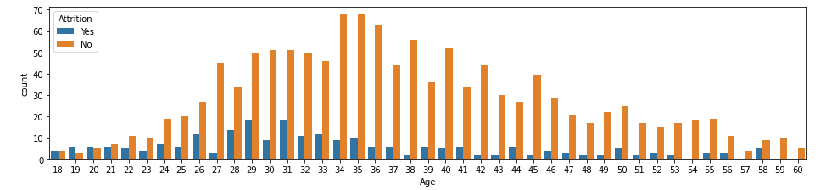
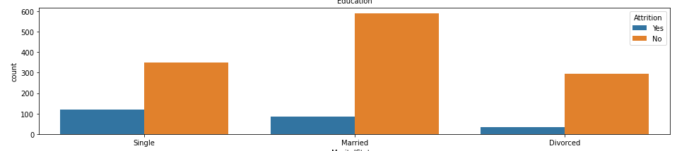
Exploring Attrition Trends Staff Personal Details
Higher attrition in people aged 31 and younger (except aged 27)
Higher attrition in Singles
Notes:
Staff Personal Details.

Slide 9
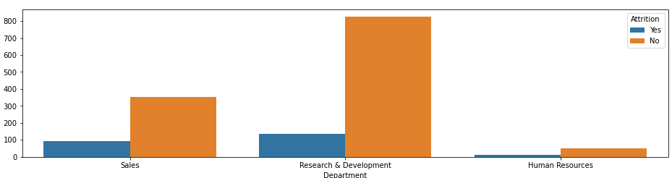
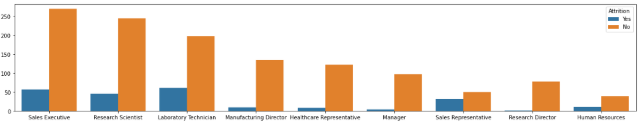
Exploring Attrition Trends Staff Profile @ Work (1)
Higher % attrition in Sales and HR than in R&D
Higher % attrition in Lab Techs and Sales Reps
Notes:
Higher attrition in Sales and HR. Could it be due to nature of job? Sales is more volatile.
HR and Sales smaller groups in the company. We can tell R&D is a big part of the company’s business. HR and Sales maybe feels underappreciated?
Higher attrition in certain job roles. Sales Reps feel underappreciated? Sales Execs are ok compared to the reps.
Lab Techs Unhappy with supervisors? Perhaps can do focus group with these staff.

Slide 10
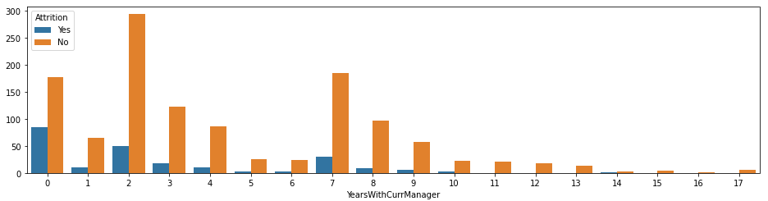
Exploring Attrition Trends Staff Profile @ Work (2)
Higher % attrition for those who have new supervisors
Notes:
Many people leave after changing supervisors. Do supervisors that require more training to be more effective in communication with their team?

Slide 11
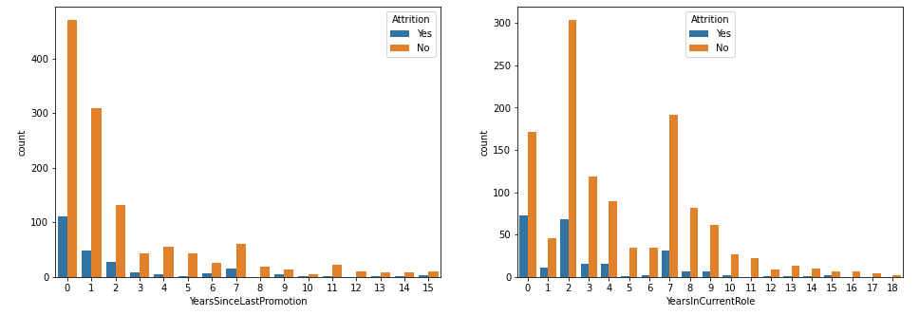
Exploring Attrition Trends Staff Career Progression
Quick promotion in company, staff leaving soon after
Job rotation seems to happen after 2 years in current role, staff leaves soon after rotation
Notes:
Is promotion too fast? Close to 1/3 of company promoted in the last year. People wait for promotions then leave right after.
Is job rotation putting staff in jobs that do not have good fit with their skills/interests? Job rotation too fast?

Slide 12
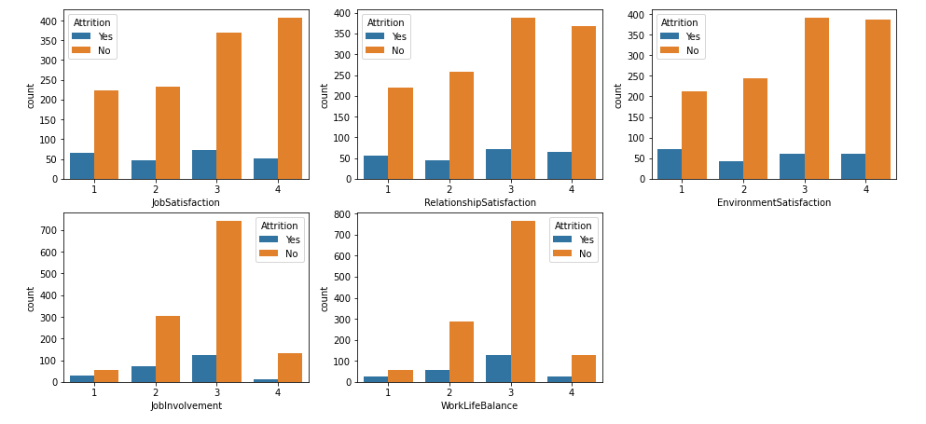
Exploring Attrition Trends Staff Surveys
Staff who rated surveys low have higher chance of leaving the company
Notes:
Staff who rated surveys low have higher probability of leaving the company. It’s all those rated 1 and 2.
But not all people who left rated low. People hide their true thoughts during staff surveys. So we have to look at a mix of variables, not just the survey results.

Slide 13
Model Building
2
Predict attrition using machine learning
Notes:
After exploring data, it’s time to build the model for our calculator.

Slide 14
Model Building Summary of Steps
Feature Engineering & Selection
Model Testing & Evaluation
Final model
Build the calculator
Keep important data points
Remove ‘noise’
Logistic Regression
Random Forest Classifier
Logistic Regression Model
25 Drivers of Attrition
Overall Accuracy of 78%
Create web app for users
Notes:
Accuracy to predict retention – 86%
Accuracy to predict attrition – 50%
Iterative process of determining data points to use and testing them out in different modelling techniques.
Then I get the model I’m happiest with.
With 25 key data points & overall accuracy of 78%
I then use that model to build the attrition calculator.

Slide 15
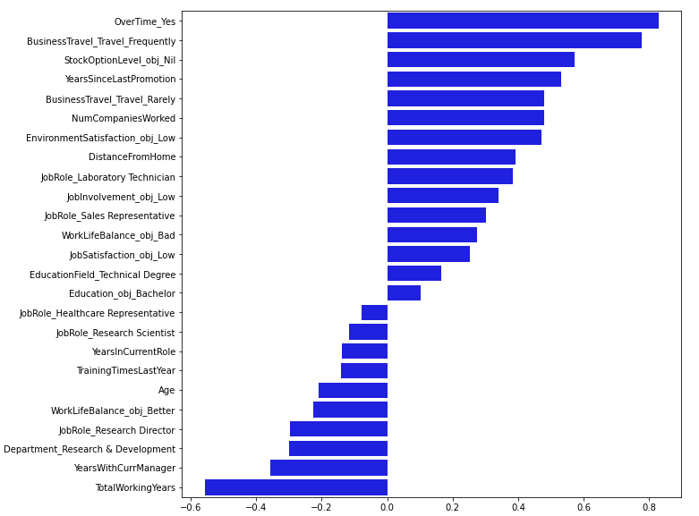
Model Building Drivers of Attrition
⇧ Attrition
Overtime
Travels Frequently / Rarely for Business
Nil Stock Options
Worked for more companies
Home further from office
Job roles as Lab Techs, Sales Reps
Rated low in surveys : Environment Satisfaction, Job Involvement, Work Life Balance, Job Satisfaction
Bachelor’s Degree
Studied Technical Field
⇩ Attrition
Note: Drivers are not necessarily causing attrition but are key traits that increase probability of staff leaving
Notes:
The 25 key data points are listed in the table on the left.
For the non-technical viewers, I have summarized the key drivers of attrition on the right.
Some of the findings are not surprising given that we have expected it from data exploration. E.g. Those rated low in surveys and job roles as lab techs/ sales rep.
Factors on the other side of the axis are traits that lower the chance of attrition. Not main focus in this presentation.
Important to note. Drivers does not mean necessarily mean causation. E.g. because someone is a Labtech, doesn’t mean they resign because of that.

Slide 16
Model Building Limitations
Able to identify staff but not necessarily underlying reasons
Periodic testing for policy changes / behavioral changes
Notes:
Limitations
What the calculator can do is to identify if the staff has high chance of leaving based on these traits but it cannot tell you the underlying reason why the staff is leaving.
The management needs to step in to speak with the staff if they wish to retain him/her. E.g. Lab Tech. why are lab techs / sales reps leaving?
Due to policy / behavioral changes, it is natural for the model to be less effective after some time. The underlying model needs to be test periodically, eg. Once a year. And revised if needed.

Slide 17
Calculator Demo
3
How to use the web app

Slide 18
Thank you!
Any Questions?

